Slide 1
PHYS 1030 Tutorial 2
Yutong Zhao
Department of Physics and Astronomy
University of Manitoba

Slide 2
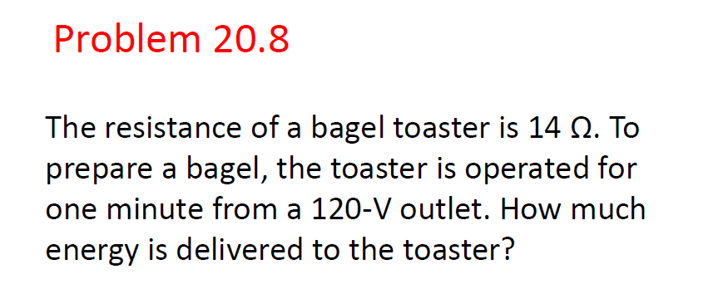


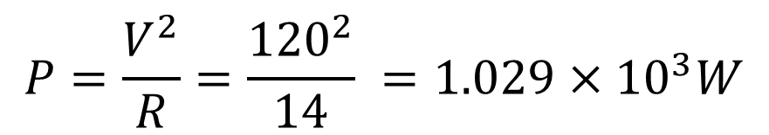
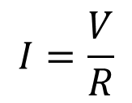


$$E=Pt$$
$$1\min{=} 60s$$
$$P=IV$$
$$I=\frac{V}{R}$$
$$E=Pt=6.171×{10}^{4}J$$
$$P=\frac{V^{2}}{R}=\frac{{120}^{2}}{14} =1.029×{10}^{3}W$$

Slide 3
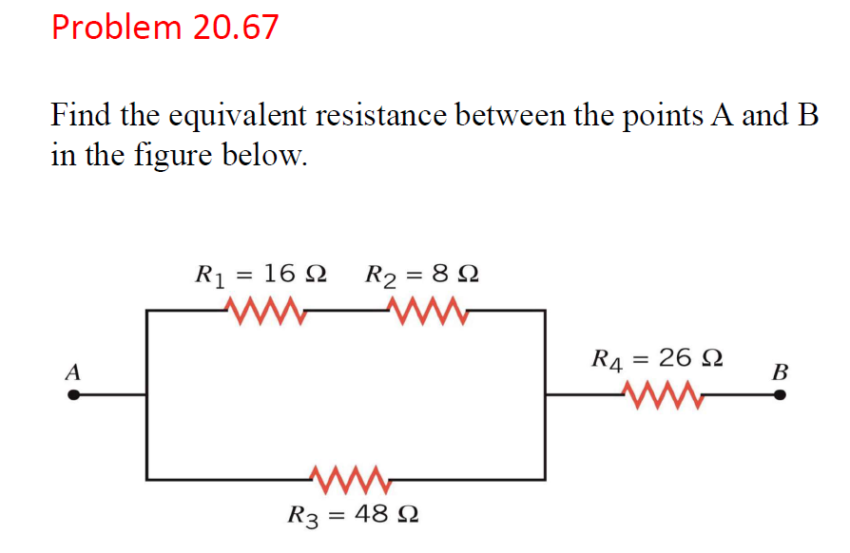


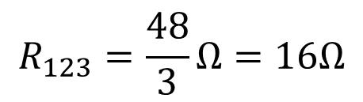
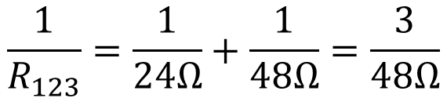



$$R_{1}+R_{2}=16Ω+8Ω=24 Ω$$
$$16 Ω$$
$$Ω$$
$$24 Ω$$
$$\frac{1}{R_{123}}=\frac{1}{24Ω}+\frac{1}{48Ω}=\frac{3}{48Ω}$$
$$R_{tot}=16Ω+26Ω=42Ω$$
$$R_{123}=\frac{48}{3}Ω=16Ω$$

Slide 4
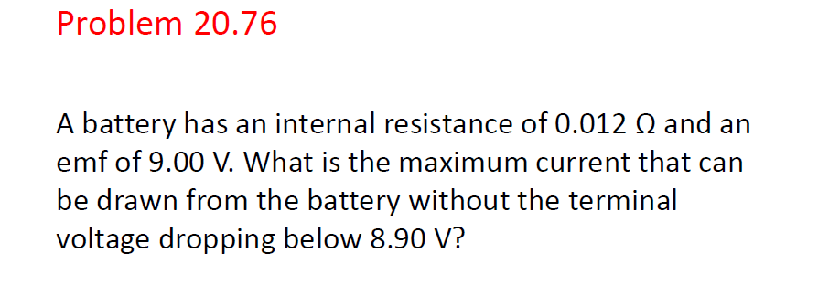



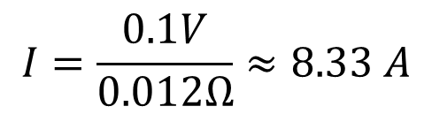

$$V=9.0 V −I×r=8.90 V$$
$$I×r=9.0V −8.90 V$$
$$0.012Ω$$
$$I=\frac{0.1V}{0.012Ω}≈8.33 A$$
$$9 V$$

Slide 5
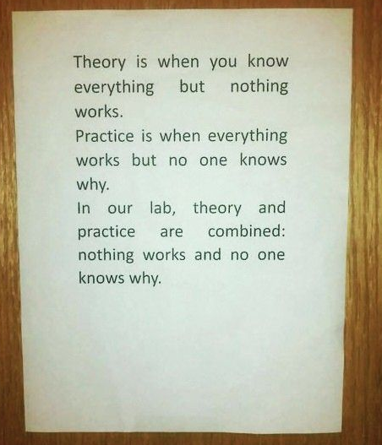

Copyright @Sylvia's Blog

Slide 6
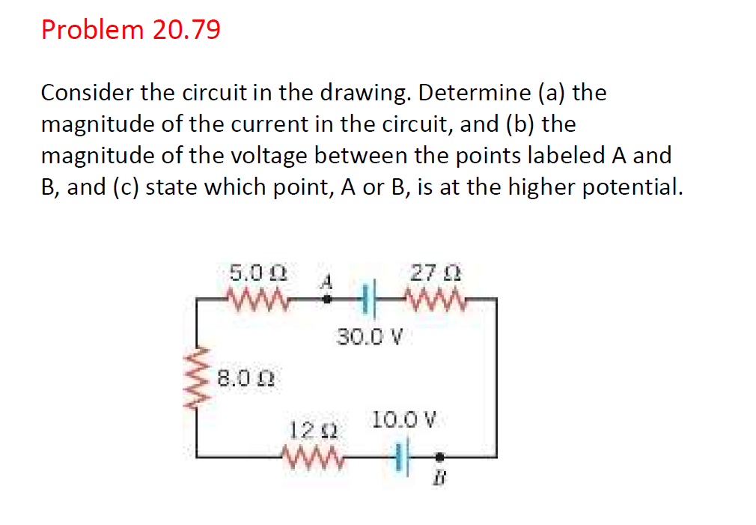

Slide 7
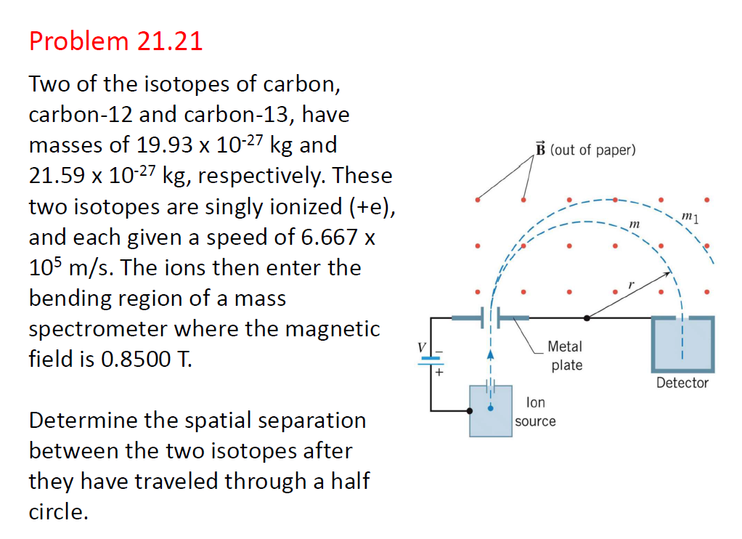

Slide 8
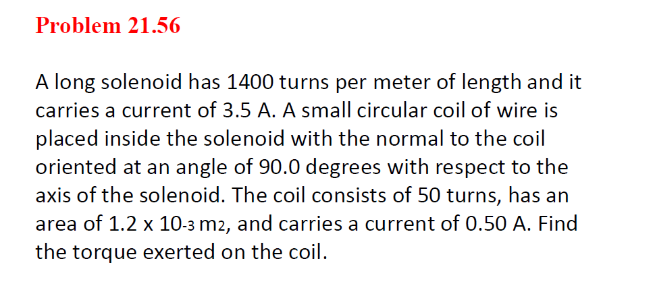

Slide 9





